Slide 1

Workflow Queue (WFQ) Administrator Application
Spring 2026 Status Review
Technical Contacts: Edmundo Guzman-Meza, Denise Tabilas
Project Advisor: Huiping Guo

Slide 2

Team Roles & Contributions
Everyone
Slok - Dev Ops Engineer, SDD & SRD Document, User Story Contribution
Haik - Integration Testing/Development, SDD Document
Alexander - Integration Tester, SDD Document
Dylan - Backend Developer, SDD Document
Edwin - Recorder, Architecture Document
Laila - Tester/Quality Assurance, SDD Document
Ruben - Team Lead, SSD Document, Tester, Backend, Frontend
Samuel - Frontend Developer, SDD Document
Zhen - Database Developer, SSD Document
Jesus - Backend Developer, Integration Testing, SDD Document

Slide 3


LQTC Overview
Dylan Huang
Company Profile: QTC (a Leidos Company) is the nation's largest provider of government-outsourced occupational health and disability exam services
Scale of Operations: Processing 4 million+ pages of medical records daily
The Problem: With this volume of data, the current reliance on manual SQL scripts to configure workflows is:
Inefficient for IT staff
High-risk for data integrity
Not scalable for rapid workflow changes
Notes:
To understand the stakes of this project, we have to look at the scale of QTC Health Services. As the nation’s largest provider of disability and occupational health exams, QTC isn't just handling data; they are processing over 4 million pages of medical records every single day. Currently, the workflows that manage this massive volume of data are configured manually. When a workflow needs to change, or a process gets stuck, an IT professional has to manually write and execute SQL scripts directly against the database. This creates three major problems: Inefficiency: It bottlenecks the IT staff with repetitive tasks. Risk: Manual data entry always carries a high risk of human error, which is dangerous in a healthcare setting. Scalability: As QTC grows, manual scripting simply cannot keep up with the demand for rapid workflow changes.

Slide 4


Project Objective
Dylan Huang
Objective: Develop an Administrator application for the QTC Workflow Queue (WFQ) system
Solution: Replace manual database interactions with a secure, GUI-based tool.
Core Capabilities:
Safe Configuration: Create/Edit workflows without writing SQL.
Task Intervention: Reassign or complete stuck tasks via the UI.
Compliance: Enforce authorization and audit logging automatically.
Notes:
Our project objective is to eliminate that risk by developing the Workflow Queue Administrator Application. Essentially, we are building a secure Graphical User Interface (GUI) that replaces those manual SQL interactions. Instead of writing code, an administrator will use our web tool to manage the system safely. We are focusing on three core capabilities: Safe Configuration: We want Admins to create and edit workflows visually, without ever touching a line of SQL. Task Intervention: If a task gets 'stuck'—for example, if an employee leaves the company while a file is assigned to them—managers can reassign or complete that task instantly via the UI. Compliance: And most importantly, because this is a healthcare environment, our system automatically enforces authorization and logs every single action for HIPAA audits. Now, to explain how we documented these requirements, I’ll hand it over to ...

Slide 5


Requirements & Design Documentation Overview
SDD (Software Design Document)
Architecture
Data flow
Constraints
Security (HIPAA section)
Jesus

Slide 6


Compliance And Regulatory Requirements
Zhen Zhao & Samuel
To ensure compliance with U.S. healthcare privacy laws, the system must meet the standards defined by HIPAA and HITECH.
HIPAA - a federal law that protects patient health information. It requires safeguards to ensure confidentiality, integrity, and limited access to sensitive medical data.
HITECH - A law that strengthens HIPAA by increasing penalties for improper access, expanding requirements for data breach notifications, and promoting secure electronic health record practices
This means the software must:
Allow only authorized users such as admins to access data
Admins are only allowed to see what is necessary
Sessions are timed out after periods of inactivity
Confirmations are needed before committing critical actions
Display masked identifiers when possible such as birthdays

Slide 7
Software Design Document (SDD)
Haik
Dependencies and Challenges (2.1)
We are entirely dependent on Existing WRF Database Schema and its procedures.
Risk of Data Corruption if an operation is not handled correctly. To mitigate this risk, all database operations will use atomic transactions. Which ensures that an operation is either fully completed or fails completely.
Constraints (2.2)
Standards Compliance - HIPAA and PHI
Existing Technology Stack - Constrained to the limitations of C#, MS SQL and ASP.NET. Mainly to ensure reliability, maintainability and consistency within QTC’s ecosystem.
Admin UI Module (6.1)
Render data from backend into user-friendly view.
Perform Client-Side input validation
Initiate all system actions by sending structured HTTP requests to the Admin Backend Module.
Display system status, confirmations and error messages returned from the backend.
Guidelines and Restrictions (5)
Security regulations including RBAC (Role Based Access Control and compliance with federal law.
Design Considerations (2)
Architecture
System Architecture
Policies and Tactics
Detailed System Design (6)
Detailed Lower Level Component Design
Database Design (8)
User Interface (UI)
Requiring Validation and Verification
Glossary and References

Slide 8
Software Design Document (SDD)
Haik
Data Access Module (6.4)
Purpose is to encapsulate all database interaction logic.
Authorization Module (6.5)
Determines if the user is an Admin.
Exports an authorization policy or mechanism that can be applied to controllers.
Design Rationale (8.4)
Normalization allows for minimum redundancy and high data integrity
Auditability, all tables include CreatedBy, CreatedDate, UpdatedBy. And UpdatedDate for full traceability.
Scalability, Separation between Task, Item and Workflow allows distributed task processing and reporting scalability.
Design Considerations (2)
Architecture
System Architecture
Policies and Tactics
Detailed System Design (6)
Detailed Lower Level Component Design
Database Design (8)
User Interface (UI)
Requiring Validation and Verification
Glossary and References

Slide 9
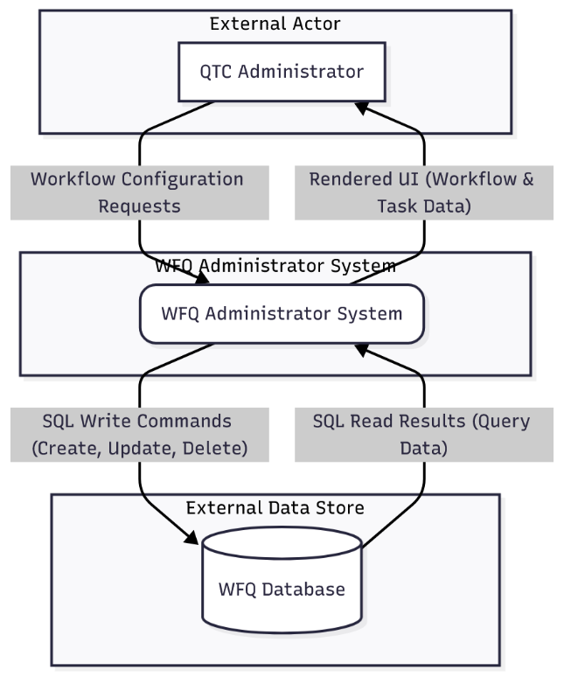
System Architecture & Integration
Haik
Modern Web Framework: Built on ASP.NET Core 8 MVC, utilizing Razor Views and custom Bootstrap for a responsive, Section 508-accessible frontend.
Strict "Database-First" Integration: Utilizes Entity Framework Cores to safely map to Leidos QTC’s existing SQL Server 2022 WFQ database.
Zero-Schema Constraint: Interfaces entirely with legacy tables (Workflow, Task, Item) and stored procedures without altering the underlying data structures.
Security & HIPAA Compliance: Enforces query-string authorized access (?admin=true) via a custom AdminAuthorizationFilter, with all multi-step data mutations wrapped in atomic transactions.

Slide 10
How Requirements Drove Our Design Decisions
Dylan Huang
Authentication & Authorization (SRS 4.1)
→ Enforced via admin-only access and server-side RBAC checks (SDD 6.4).
Compliance Requirements (HIPAA/HITECH)
→ Audit fields preserved, HTTPS/TLS required, and sensitive data protected (SRS 2.6; SDD 2.2).
Multi-Step Operation Safety
→ Complex operations (e.g., safe-delete) run inside transactions to avoid partial updates (SDD 7.2.4.5).
Security Requirements (SRS 5.3)
→ HTTPS enforced and authorization checked for every admin action (SRS 5.3; SDD 3.8, 6.4).
Workflow Rules (SRS 4.2 & 4.3)
→ Deletion restrictions, dependency checks, and reassignment rules built into the service layer (SDD 7.2 & 7.3).
Performance Awareness
→ Pagination and indexed queries help meet response-time expectations (SRS 5.1; SDD 3.10, 6.1.3).

Slide 11


Technical Environment Setup
Haik
SQL Server 2022 installed and configured
Configured the correct SQL services
SQL Server instance
Verified the database engine
SSMS fully configured
QTC-provided database connected
IIS enabled with ASP.NET Core 8 MVC, Entity Framework Core (EF Core), and Bootstrap 5 / HTML5.

Slide 12

Database Architecture
Samuel Acevedo
QTC provided their existing WFQ SQL Server database structure.
No schema changes are made; the new UI strictly uses the existing tables and stored procedures defined in the WFQ system.
All data operations follow QTC’s established workflow rules and stored procedure logic.
Core Tables used:
- Workflow: Defines each workflow
- WorkflowStep: Ordered steps within a workflow
- Task: Tasks generated for each step of the workflow
- Item: The object being processed (main business record)
- Status/ItemStatus: Standardized workflow and task statuses
- InfoKey/ItemKeyValue: Key-value metadata for dynamic item properties
All admin operations use transactions for data integrity.
The Admin UI only becomes active when launched with a flagged Admin route, ensuring restricted access.
Notes:
SQL server - accessed by strings “flagged Admin”
For users, tasks, queue items, logs

Slide 13
System Context Diagram
Ruben Flores
The System Context Diagram shows how the WFQ Administrator Application fits into the larger environment.
It identifies who uses the system, what information they send to it, what information the system returns, and what external systems or databases it interacts with.
It provides a simple, high-level view of the system so anyone can understand the major connections and data flows without needing technical knowledge.

Slide 14

How Our System Is Structured
Laila Velasquez
Admin Website (UI): What the QTC admin sees: pages, tables, buttons, forms
Rules & Decisions (Logic Layer):
Decides what’s allowed:
“Is this user an admin?”
“Can this step be deleted?”
“Where should tasks go next?”
Database Access: Layer Safely reads and writes the existing WFQ database, without changing its structure.

Slide 15
User Story - Admin Manager Zhen Zhao
As an Admin Manager I want the UI to be easy to access and easy to understand so that i can quickly teach new admins how to quickly create and edit workflows
Acceptance Criteria:
UI Labels And Buttons should use simple non-technical language that is easy to understand and explain
When a workflow is created on the UI it shows the date and time it was created
In order to access workflows admins must login with a username and password
A edit feature so if a admin makes a mistake on a workflow it can be corrected
Technical Tasks:
Update UI Labels to use plain-language terminology
Add date and time feature towards workflow step
Make sure workflow cant be accessed without logging in
Implement edit feature for the ability to edit workflow steps

Slide 16
User Story — Admin
Laila Velasquez
Create New Workflow
As an Admin, I want to create a new workflow so that I can configure new processes in the system.
Acceptance Criteria:
Workflow name is required. The workflow name must be unique. Description is optional. On success, the workflow appears in the workflow list. On failure, a clear error message is shown.
Technical Task:
[ ] Frontend: Add “Create Workflow” button and workflow creation form. [ ] Backend: Validate workflow name uniqueness before insertion. [ ] Backend: Insert workflow record into database. [ ] Backend: Return success or validation error messages. [ ] QA: Test workflow creation with valid and duplicate workflow names.
Notes:
Laila

Slide 17
User Story — User
Laila Velasquez
Improve Search Function in Workflow Queue
As a User, I want to quickly search for workflows or tasks using keywords so that I can find specific items without scrolling through long lists.
Acceptance Criteria:
The search bar filters workflows by name or description. Search results update dynamically when a keyword is entered. Search supports partial matches (e.g., typing “test” finds “Testing Workflow”). Search resets when the search box is cleared.
Technical Task:
[ ] Backend: Update SQL queries to support keyword filtering using LIKE conditions. [ ] Backend: Optimize search query performance for fast response times. [ ] Frontend: Implement dynamic filtering behavior tied to search input. [ ] QA: Test search accuracy, responsiveness, and reset behavior.
Notes:
Laila

Slide 18
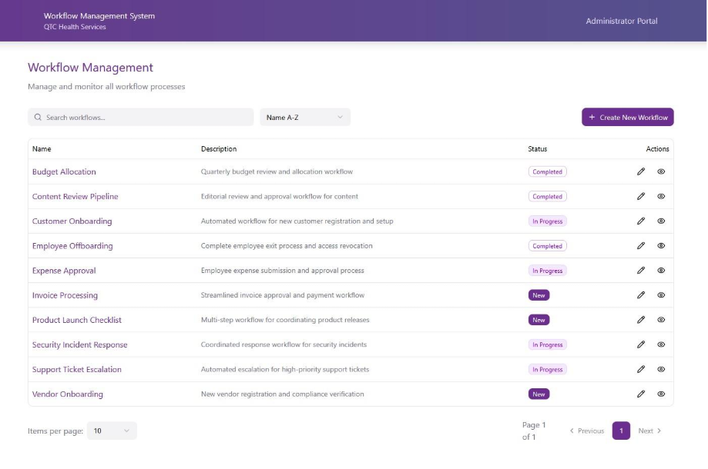
User Interface (UI) Examples
Jesus
High level view of WFQ admin UI
Web Based admin UI thats the main way to manager and monitor WFQ workflows. Its built for clarity, efficiency, and matches Leidos branding while communicating with the backend via internal Controller Actions.
Dashboard / workflow list shows all workflows a user can access, with sortable columns (Name, Status, Created Date) and actions like Edit and View Steps.
Workflow Step and Task pages show steps and assigned task, with actions like Edit, Delete, Complete Task, and Reassign.
Search and filter controls the admin interface let users find workflows/tasks and create or update workflows, steps, and tasks, with on-screen status messages, confirmations, and error messages.

Slide 19
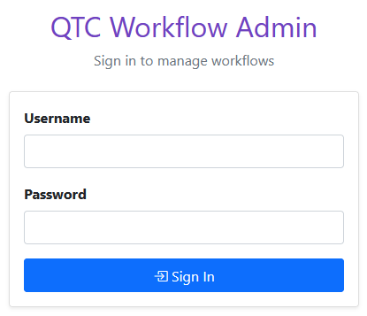
User Interface (UI)
Ruben,Alexander
User enters username + password into the login form.
Form sends credentials to the Login POST action in HomeController.
System calls a function UserService.ValidateUser(username, password) to verify credentials against stored users.
If credentials match: user is authenticated.
If credentials fail: system returns an error message ("Invalid username or password").

Slide 20
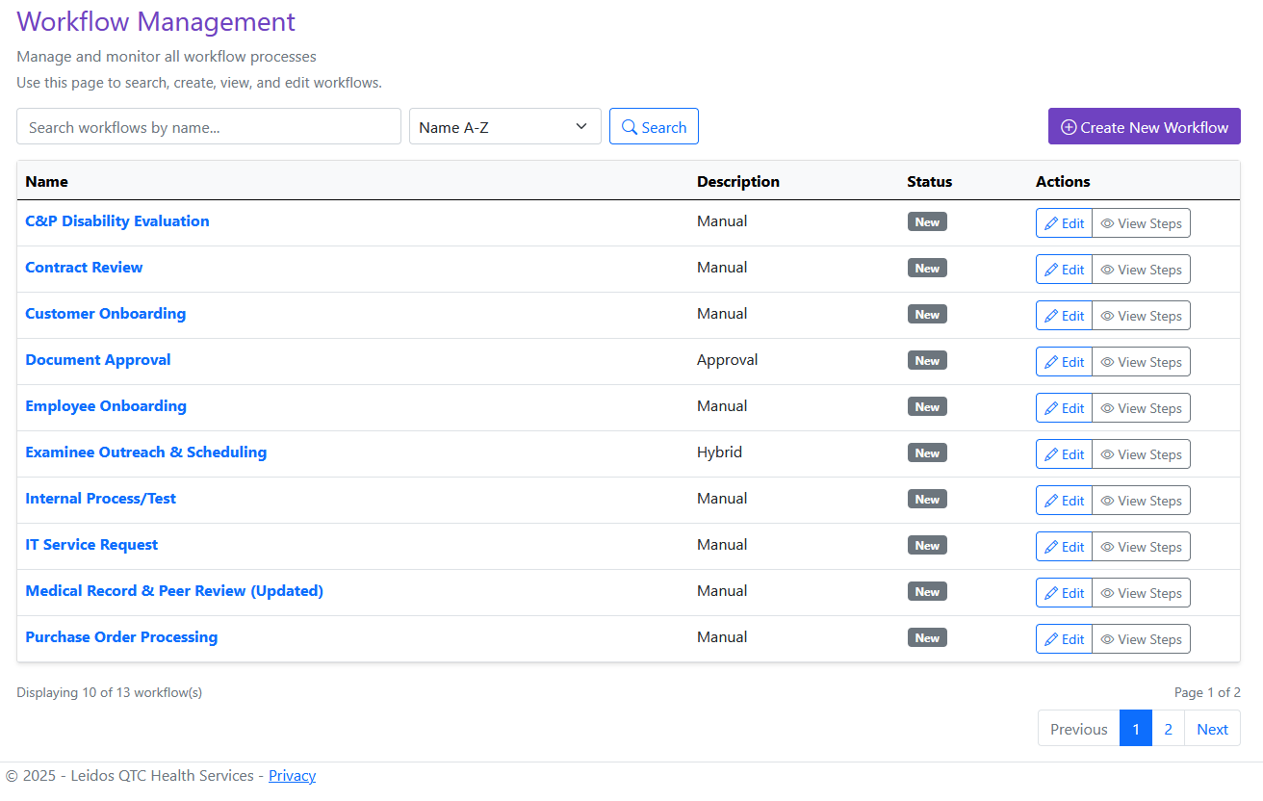
User Interface (UI)
Ruben,Alexander
Displays all workflows in a table format for easy viewing
Shows workflow details such as name, type, dates, and record limits
Role-based interface: admins see additional controls and data
Search and sorting features help users quickly find workflows
Action buttons allow users to view, edit, delete, and reorder workflows
Connected to backend services to pull real-time workflow data from the database

Slide 21
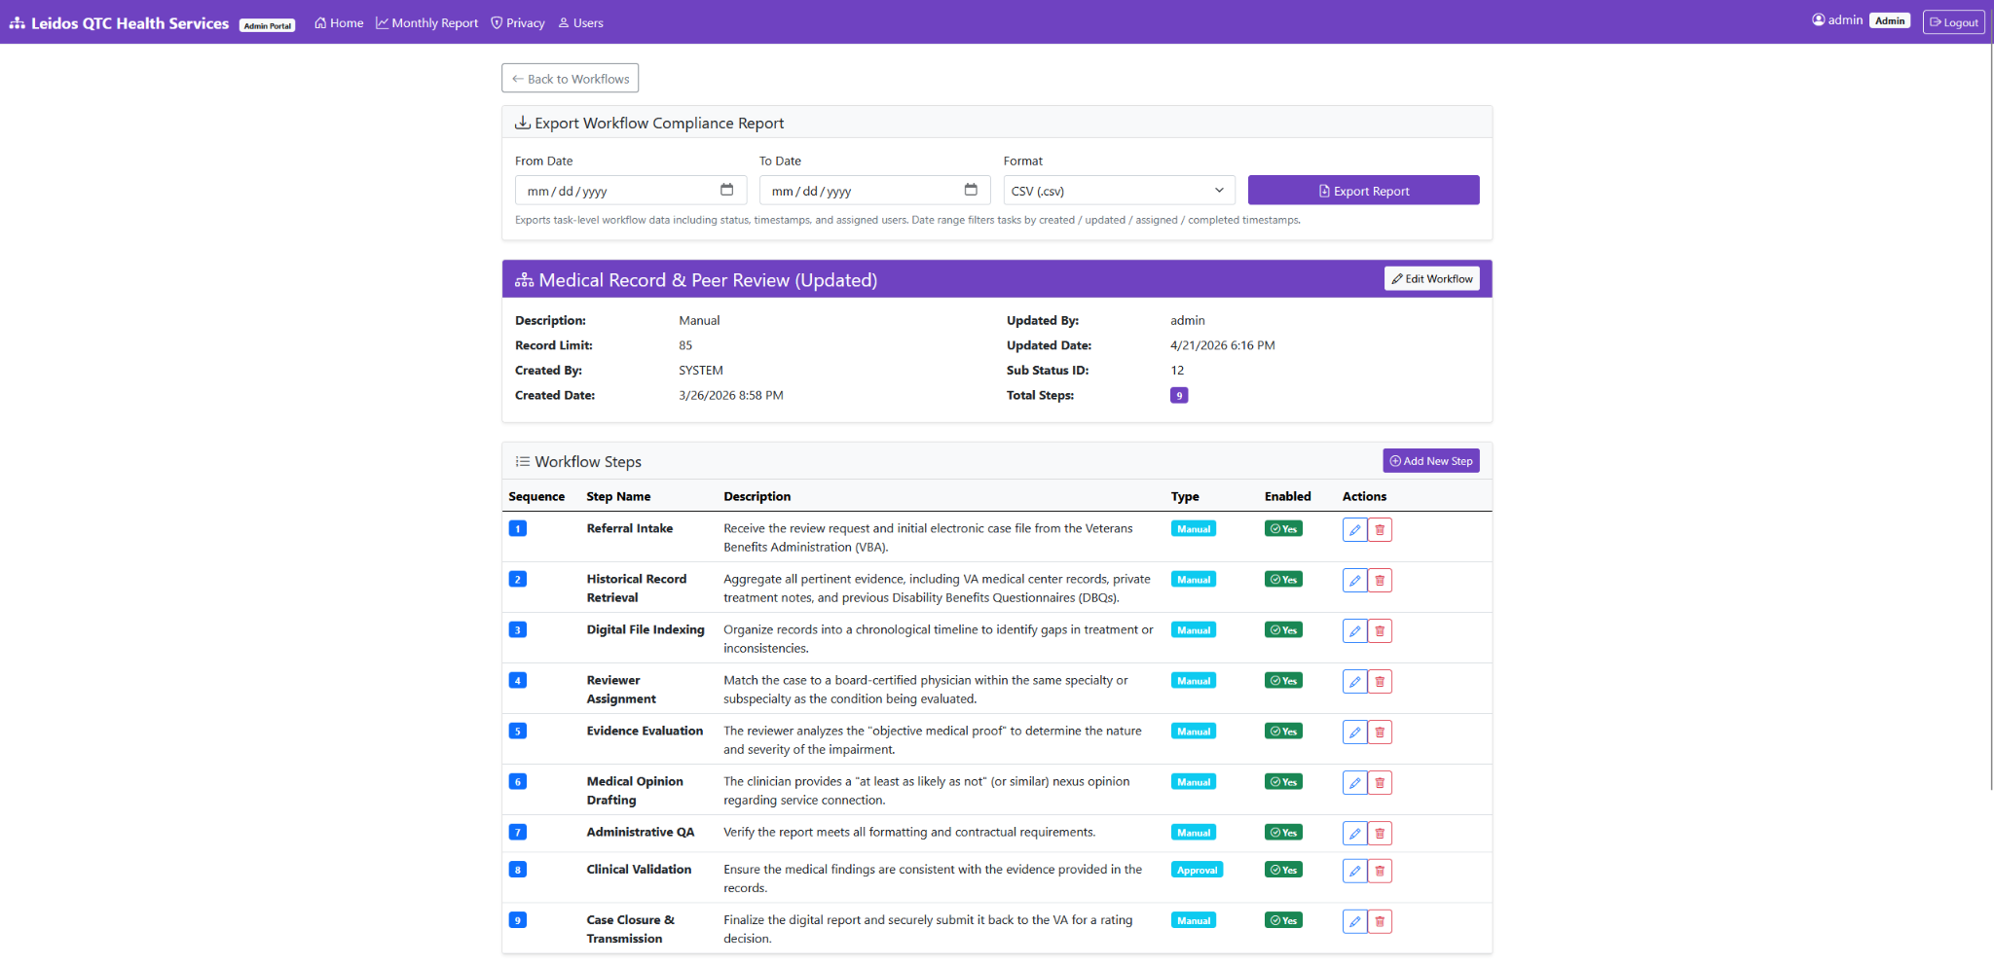
User Interface (UI)
Jesus

Slide 22
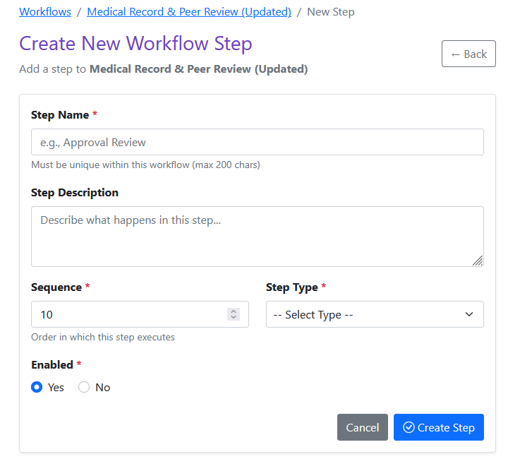
Dynamic Workflow Configuration
Edwin Rojas
Multi-Layered Input Validation: Enforces strict 200-character limits, sanitizes whitespace, and prevents duplicate workflow names via asynchronous server-side database checks.
Asynchronous Duplicate Prevention: Queries the legacy database in real-time to ensure new workflow names are strictly unique before insertion.
Secure Database Insertion (EF Core): Maps the validated form directly to the legacy Workflow table using Entity Framework Core, abstracting away vulnerable raw SQL syntax.
Automated Audit Initialization: Programmatically injects the exact timestamp and system metadata into the CreatedBy and CreatedDate fields during the initial transaction.

Slide 23
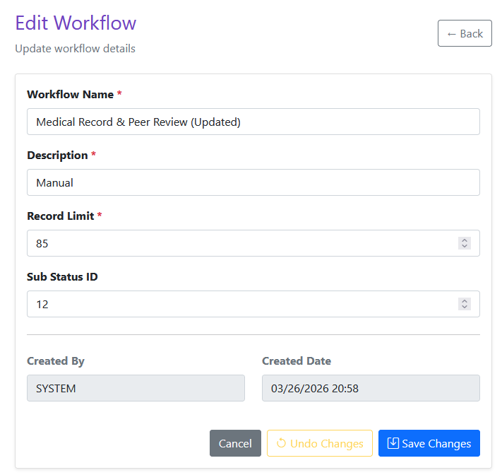
Dynamic Workflow Configuration
Edwin Rojas
Validates modifications against existing records, ensuring renamed workflows don't collide with other active workflows in the system.
Automatically captures the active administrator's session ID and injects it into the UpdatedBy field for continuous audit trailing
Translates backend database constraint violations into safe, user-friendly UI alerts without exposing sensitive database stack traces

Slide 24
Time for The Demo

Slide 25
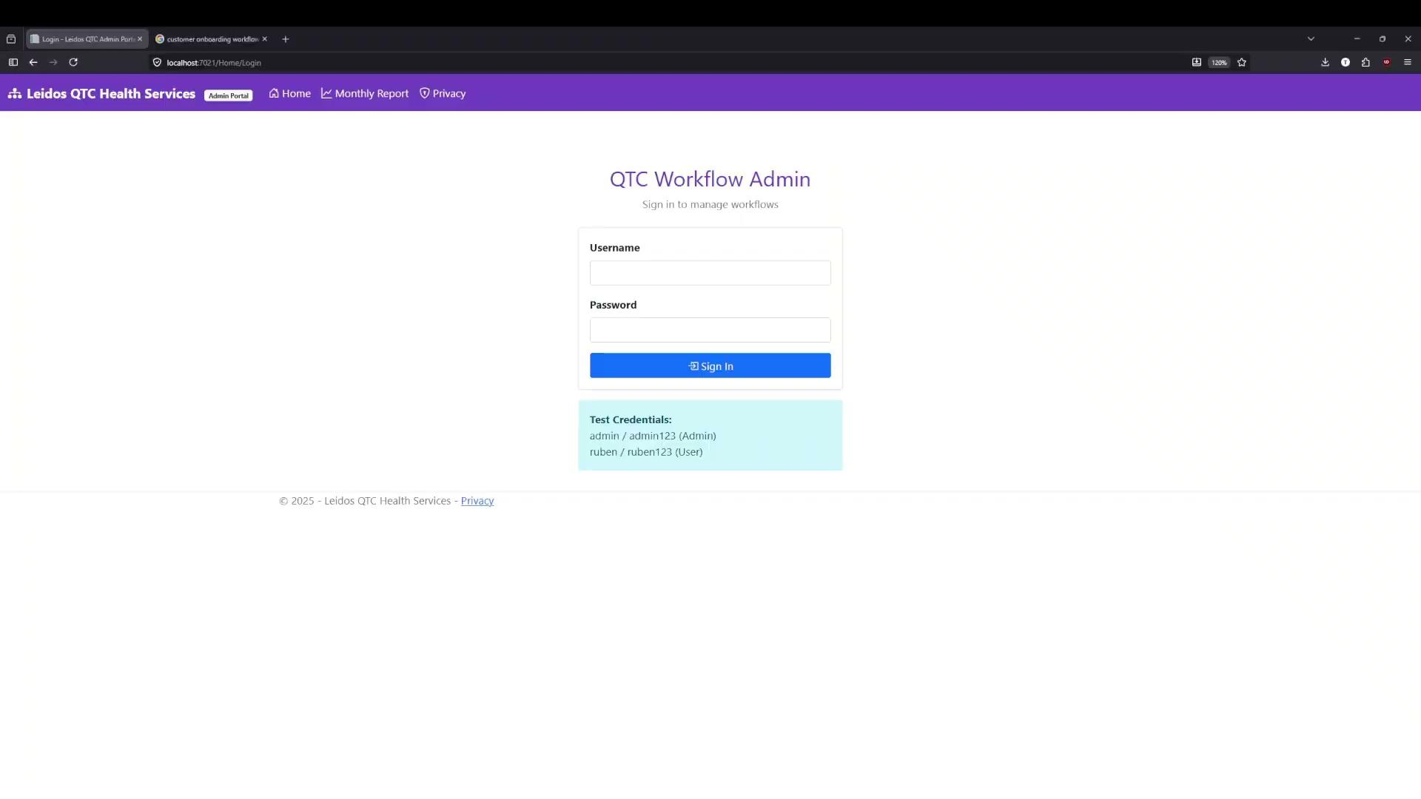

Slide 26

Current Backlog & Final Polish
Slok Patel
Performance Optimization: Refactoring high-volume LINQ queries to perform MIN/MAX aggregations at the SQL level, preventing server memory bottlenecks.
Authentication Hardening: Migrating the custom in-memory HTTP Session state to a Distributed Cache or Cookie Authentication for multi-server reliability.
Production Readiness: Stripping out development bypass flags (e.g., URL query-string auto-logins) to lock down the application before final hand-off to Leidos QTC.

Slide 27

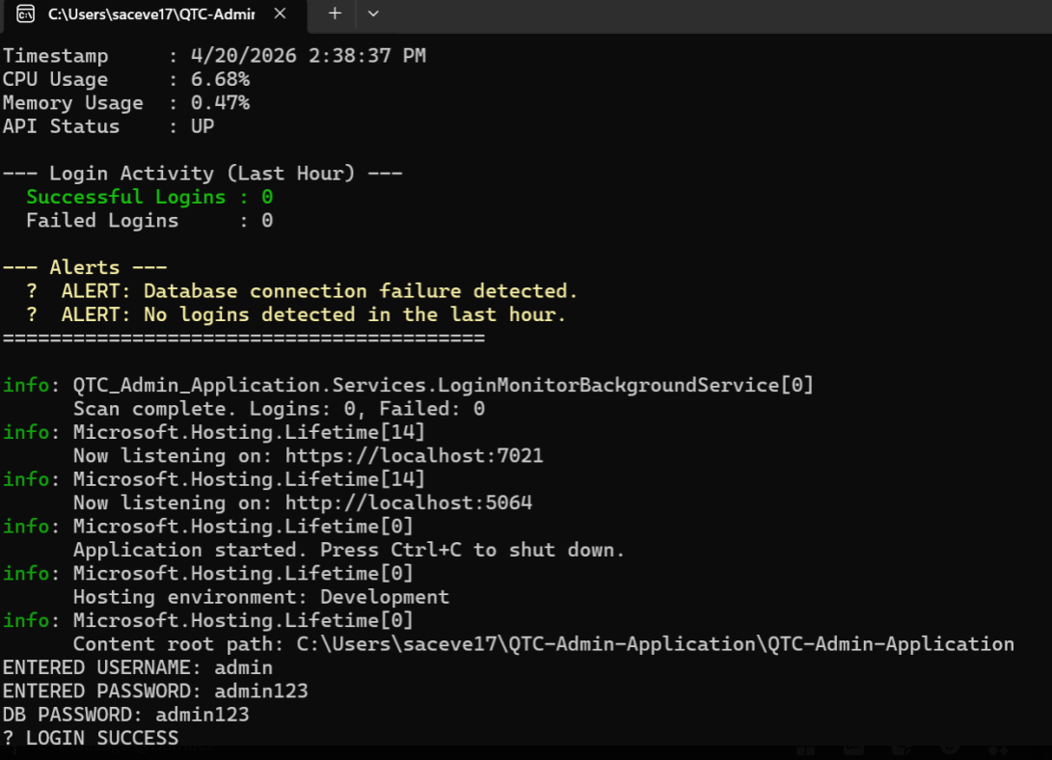
Spring Milestones
Slok Patel
🚀 Workflow System
End-to-end workflow execution
Create → Manage → Execute
Step sequencing validated
🔐 Security & Access
Login system (username/password)
Role-Based Access Control (RBAC)
🖥️ User Interface
Workflow dashboard with table view
Displays name, status, steps, metadata
Built-in search & sorting
Action controls
View, Edit, Delete workflows
Detailed workflow view with step management
⚙️ Performance & Monitoring
Optimized APIs for fast performance
System monitoring & alerts
📊 Reporting
Export reports (CSV/PDF)

Slide 28
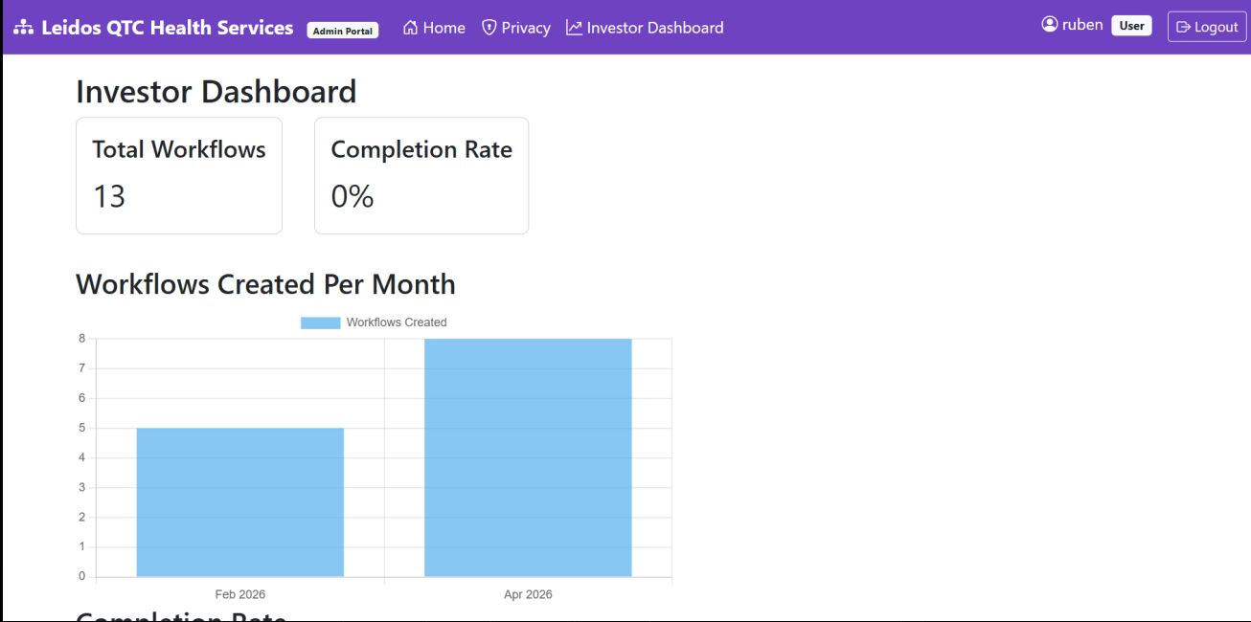

Spring Milestones Cont.
Slok Patel
💡 Business Impact
Eliminated manual SQL configuration
Workflows managed directly through UI
Improved security
Authentication + RBAC
Increased efficiency
Faster search, editing, reporting
Provides high-level insights for stakeholders
Investor dashboard with metrics & trends
🖥️ Real System Usage
Centralized workflow dashboard
Structured table view of workflows
Interactive controls
Edit, view, manage steps
Detailed workflow pages
Full configuration visibility
Real-time data
Live backend integration
📊 The System & it’s Capabilities
Handles high-volume workflows
Real-time visibility
Auditable execution
Reliable compliance reporting

Slide 29
Fall Milestones Completed
Slok Patel
Deployed Administrator Portal: Successfully launched the ASP.NET Core 8 MVC frontend with responsive, 508-compliant Razor Views.
Database-First Integration: Fully integrated Entity Framework Core with the legacy WFQ SQL Server without altering existing schemas.
Dynamic Workflow Engine: Delivered safe Create/Edit/Delete capabilities for Workflows and Workflow Steps using atomic transactions.
Task Intervention Logic: Engineered secure backend services allowing administrators to reassign, unassign, and force-complete stuck medical tasks.
Automated Compliance Reporting: Integrated the QuestPDF library to generate and export heavily formatted, time-stamped Compliance & Performance reports (CSV/PDF).

Slide 30


Challenges & Next Steps
Ruben Flores, Alexander Diaz
We creating and implementing a new user interface based off of the rules and criteria set by the Software Design Document. Including integrating the new UI components with the backend.
Challenges:
Aligning UI components with Leidos branding guidelines and CSS frameworks
Close communication with team to deliver and update versions of the UI.
Making sure the new UI connects properly with backend logic

Slide 31


Outro / Questions
Alexander Diaz
In Summary: Our design process and SDD set the foundation for implementing a user interface that meet QTC’s standards
Looking Ahead: We’re now focused on implementing the updated specifications and criteria outlined in the SDD
We welcome any questions, feedback, or suggestions

Slide 32

References
Alexander Diaz
Microsoft. SQL Server 2022 Documentation. Microsoft Docs, https://learn.microsoft.com/sql/.
Microsoft. Internet Information Services (IIS) Overview. Microsoft Docs, https://learn.microsoft.com/iis/.
Wikipedia. "Microsoft SQL Server." Wikipedia: The Free Encyclopedia, Wikimedia Foundation, https://en.wikipedia.org/wiki/Microsoft_SQL_Server.
Wikipedia. "Internet Information Services." Wikipedia: The Free Encyclopedia, Wikimedia Foundation, https://en.wikipedia.org/wiki/Internet_Information_Services.
LWN.net. “Overview of the Linux Kernel.” LWN.net, https://lwn.net/.
Debian Project. Debian Administrator’s Handbook. Debian.org, https://www.debian.org/doc/.
Nubius Solutions. “ASP.NET Application Hosting Best Practices.” Nubius Solutions, https://nubius.net/.
Microsoft. ASP.NET 8 Documentation. Microsoft Docs, https://learn.microsoft.com/en-us/dotnet/

